Slide 1
OS Final Answers

Slide 2
Q1:CPU Scheduling Algo.
2pt for each chart, 1pt for wait time, 0.5pt for others.
FCFS
  Turnaround = (6+9+8+6)/4 = 7.25
  Waittime = (0+5+6+3)/4 = 3.5
  Response = (0+5+6+3)/4 = 3.5
Preemptive SJF (2 correct ans)
  Turnaround = (12+4+3+6)/4 = 6.25
  Waittime = (6+0+1+3)/4 = 2.5
  Response = (0+0+1+3)/4 = 1
  Turnaround = (15+4+3+3)/4 = 6.25
  Waittime = (9+0+1+0)/4 = 2.5
  Response = (0+0+1+0)/4 = 0.25
P1
P1
P1
P1
P1
P1
P2
P2
P2
P2
P3
P3
P4
P4
P4
P1
P2
P2
P2
P2
P3
P3
P1
P1
P1
P1
P1
P4
P4
P4
P1
P2
P2
P2
P2
P3
P3
P1
P1
P4
P4
P4
P1
P1
P1

Slide 3
Q1:CPU Scheduling Algo.
Non-Preemptive Priority
  Turnaround = (6+11+4+6)/4 = 6.75
  Waittime = (0+7+2+3)/4 = 3
  Response = (0+7+2+3)/4 = 3
P1
P1
P1
P1
P1
P1
P3
P3
P2
P2
P2
P2
P4
P4
P4

Slide 4
Q2: Real-Time Scheduling
(3pt) Real time scheduling means the jobs need to be finished before its deadline.
(2pt) EDF is better than Rate Monotonic because EDF is an preemptive adaptive algorithm.(or dynamically change priority)
*1pt is given if only illustrate by an example without correct explanation.

Slide 5
Q3: Priority Scheduling
No partial points
(3pt) FCFS: the one gets running first will increase its priority in faster rate, so its priority is always higher than the other. New jobs always have the lowest priority at 0.
(3pt) Last In First Out: The job in running or waiting always has minus priority. But the new job has priority 0, so the new job can preempt the running job. In addition, because the priority of job in the waiting queue decreases faster, the longer it waits, the later it gets to run.

Slide 6
Q4: Banker’s Algorithm
Step3:
Max Allocate Need Available
A B C A B C A B C A B C
P0 2 2 4 0 1 1 2 1 3 10 3 4
P1 6 5 3 0 0 2 6 5 1
P2 7 5 3 0 1 0 7 4 3
P3 3 2 2 3 0 2 0 0 0
P4 9 0 2 3 0 2 0 0 0
Gain 2 pt. per step
P3,P4,P0,P2,P1
Step1:
Max Allocate Need Available
A B C A B C A B C A B C
P0 2 2 4 0 1 1 2 1 3
P1 6 5 3 0 0 2 6 5 1
P2 7 5 3 0 1 0 7 4 3
P3 3 2 2 3 0 2 0 2 0 4 3 0
P4 9 0 2 3 0 2 6 0 0
Step4:
Max Allocate Need Available
A B C A B C A B C A B C
P0 2 2 4 0 1 1 0 0 0
P1 6 5 3 0 0 2 6 5 1
P2 7 5 3 0 1 0 7 4 3 10 4 5
P3 3 2 2 3 0 2 0 0 0
P4 9 0 2 3 0 2 0 0 0
Step2:
Max Allocate Need Available
A B C A B C A B C A B C
P0 2 2 4 0 1 1 2 1 3
P1 6 5 3 0 0 2 6 5 1
P2 7 5 3 0 1 0 7 4 3
P3 3 2 2 3 0 2 0 0 0
P4 9 0 2 3 0 2 6 0 0 7 3 2
Step5:
Max Allocate Need Available
A B C A B C A B C A B C
P0 2 2 4 0 1 1 0 0 0
P1 6 5 3 0 0 2 6 5 1 10 5 5
P2 7 5 3 0 1 0 0 0 0
P3 3 2 2 3 0 2 0 0 0
P4 9 0 2 3 0 2 0 0 0

Slide 7
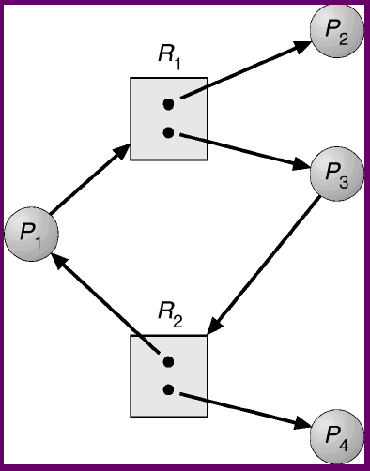
Q5: Deadlock
(a) No partial points
(2pt) Deadlock prevention defines “static” rule or policy to remove one of the four deadlock conditions.
(2pt) Deadlock avoidance implement algorithms to avoid the “possibility” of deadlock on-the-fly by monitoring the resource usage at runtime
(b) (3pt) No partial points
P2, P4 can finish first
Then their instance can be free
and allocate to P1, P3

Slide 8
Q6: Critical Section
Requirement: 2pt each
  Mutual exclusion: can’t have more than one process in the critical section
  Bounded waiting: a process only wait for a finite time for entering a critical section
  Progress: if no one in the critical section, a process wish to enter must be approved.
Proof: 2pt each
  Mutual exclusion: Process has unique ordering according to the ticket number
  Bounded waiting: Process enter the CS in FCFS order, so wait time is limited
  Progress: Also because of FCFS, the process in the first position always can enter

Slide 9
Q6: Critical Section
(c) (3pt) The ticket number may not be correct or finalized during the comparison. So we can’t guarantee the new process get the largest ticket number.

Slide 10
Q7: Monitor
(4pt.)
  Monitor is a type or a special class defined in a language for solving synchronization problem.
  A monitor is consisted a set of class variables and functions.
  The class variables can only access and modified through the class functions.
  Only one process at a time can be active within the monitor.
  Monitor also has condition variables which allows a process waits inside the monitor and resume afterwards.
(2pt)
  Mutual exclusion is guaranteed because only one process at a time can be active within the monitor

Slide 11
Q8: Semaphore
Init: sem1=sem2=0;
P1:
wait(sem1);
S1;
P2:
S2;
signal(sem2);
P3:
wait(sem2);
S3;
signal(sem1)

Slide 12
Q9: inode structure
Direct block pointer: 16*4KB
Single indirect: 4KB/4B * 4KB = 4MB
Double indirect: 4KB/4B * 4KB/4B * 4KB = 4GB
Triple indirect: 4KB/4B * 4KB/4B * 4KB/4B * 4KB = 4TB
Total: 4TB+4GB+4MB+64KB

Slide 13
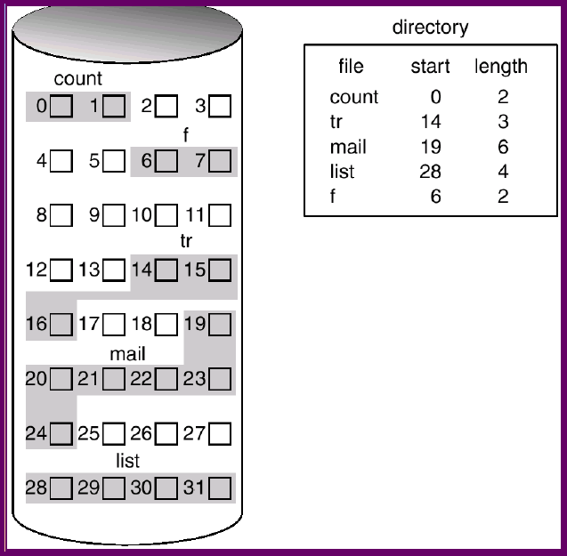
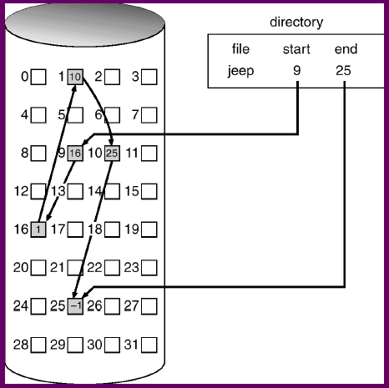
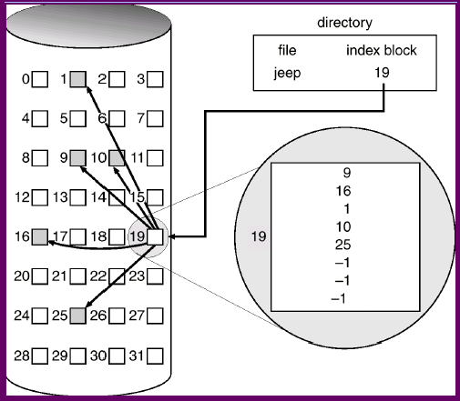
Q10:
3pt each
Contiguous
Linked Indexed

Slide 14
Q10:
(b)
(3pt) contiguous scheme should be the best answer
  because DB often has random access pattern, so linked scheme is inefficient.
  DB often has fixed size data for each column, so contiguous shouldn’t have too much fragmentation problem.
  Compare to contiguous scheme, indexed and linked scheme requires more space (both in terms of disk and memory space) to store the pointer per data block.
(2pt) If you choose contiguous scheme, and only mention it uses the minimum disk/memory space.

Slide 15
Q10:
(3pt) If you choose indexed scheme, and you mention fragmentation problem for contiguous scheme, and random access problem for linked scheme.
(2pt) If you choose indexed scheme and you only mention the fragmentation problem of contiguous scheme.
(1pt) If you choose linked scheme and you mention the fragmentation problem of contiguous scheme
(0pt) Otherwise……..

Slide 16
Q11: Disk Scheduling
3pt each
SSTF: 250, 120, 10, 840, 900, 2190, 2400
SCAN: 250, 840, 900, 2190, 2400, 120, 10
C-SCAN: 250, 840, 900, 2190, 2400, 10, 120

Slide 17
Q12: RAID
(2pt): RAID4 block-level parity bit
(1pt each ans)
  RAID0: can’t recover from any disk failure
  RAID1: waste half of disk space for redundancy
  RAID2: waste 4/7 of disk space for redundancy
  RAID3: need synchronization among disks
  RAID6: no need to consider multiple disk failures

Slide 18

Q13: DMA
(2pt): DMA relies on DMA controller to transfer data. Programming IO needs CPU to involve.
(1pt per step)
(3pt): Polling is more for small I/O, because wait time is short and no overhead from interrupt handling

Slide 19
Q14: Memory Address Translation
(i) segment index: E482=>1110 0100 1000 0010=> first 3bits (8 segments) is used=> 111 => 15
(ii) linear addr: 1 0110 0111 0110 + 0 0100 1000 0010 = 1 1010 1111 1000
(iii) page index: the first 4 bits of linear addr. (last 9 bits for page offset)
=> 1101 => 13
(iv) phy addr: 7 << 2^9 + 0 1111 1000 => 0 1110 1111 1000
E482
page table
(frame number)
Segmentation table
(segment base addr.)
(i)index?
(iii)index?
1 0110 0111 0110
(ii) linear
address?
7
(iv) physical
address?
…

